Slide 1
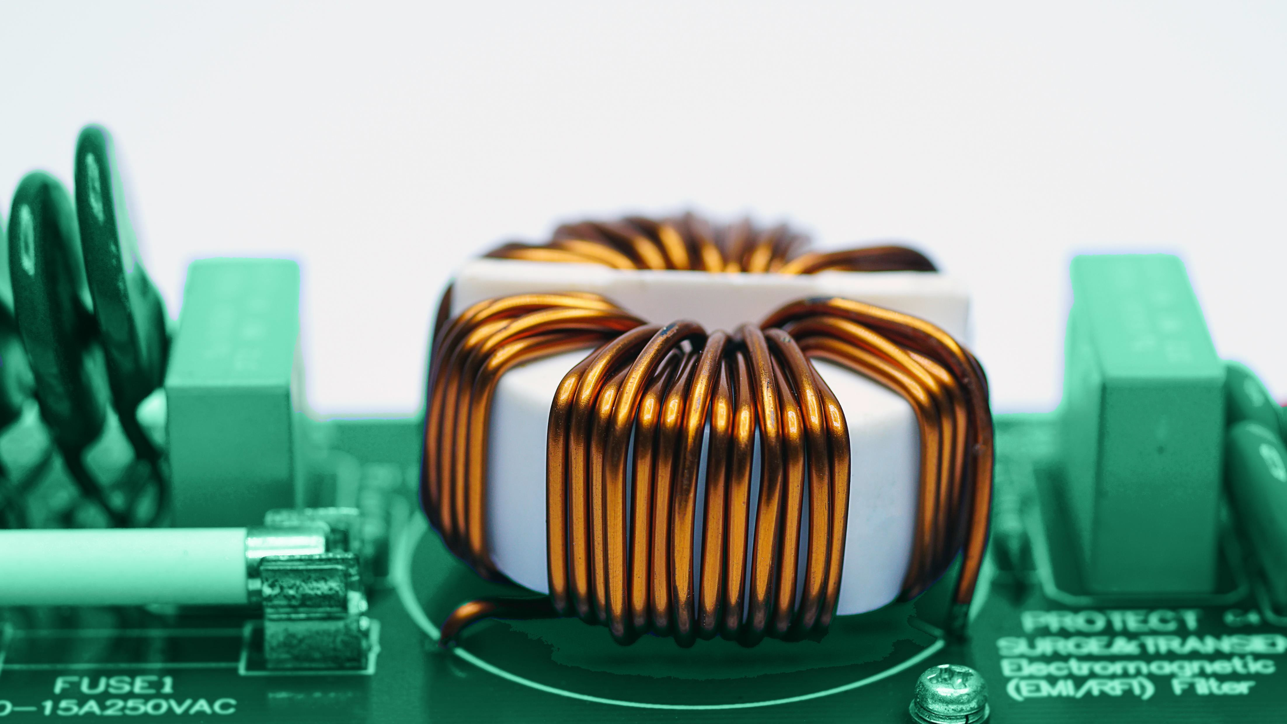


OVERVIEW
OF PERSPECTIVE
ON NANOCRYSTALLINE SOFT MAGNETIC MATERIAL (NSMM)
Bharadwaj Reddy Andapally
CBMM - Amsterdam: Technical Market Development
Specialist (Global)- Nanomaterials

Slide 2

Biography
2022- Present: Technical Market Development at CBMM -Amsterdam for
Global Nanocrystalline Soft Magnetic Materials
2020-2022: Technical Advisor at CBMM -Amsterdam for Nanocrystalline Soft Magnetic Materials
2015-2021: R&D Engineer High Frequency Magnetic Components at ISE
Magnetics- Netherlands (Spinoff -Philips & Aperam alloys)
2013-2015 Msc- Electrical Power Engineering- Power Electronics &Magnetics at TUDelft -Netherlands
BHARADWAJ REDDY

Slide 3

CBMM is the world leader in production and commercialization of Niobium products and has been in the market for over 60 years
Different products
for unique applications
Infrastructure Mobility
Aerospace Health
Energy Oil & Gas
More than 400 clients in 50 countries, in all continents
Production capacity that exceeds
current global demand
Over 60M USD per year invested in R&D
Partnership with the most renowned research centers

Slide 4

















CBMM
WORLDWIDE
CBMM is able to support your needs quickly and efficiently, guaranteed by
a global presence
and robust logistics
AMSTERDAM GENEVA
PITTSBURGH
BEIJING
SHANGHAI
TOKYO
SINGAPORE
ARAXA
SAO PAULO
HEAD OFFICE
REGIONAL
OFFICES
MINE / INDUSTRIAL FACILITY
CBMM SWISS TECHNOLOGY OFFICE
EXCLUSIVE DISTRIBUTERS
REPRESENTATIVE OFFICES

Slide 5
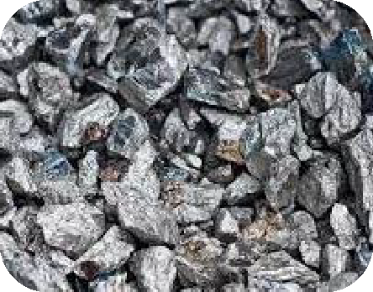
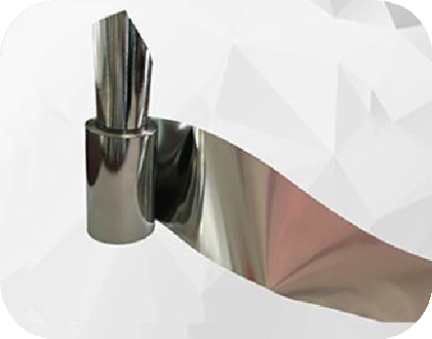
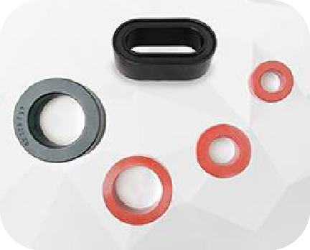
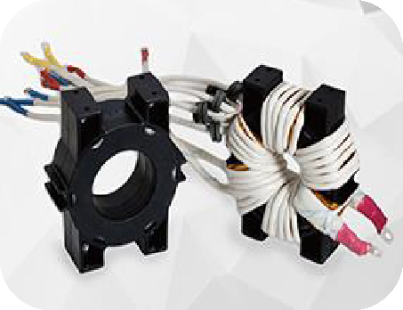
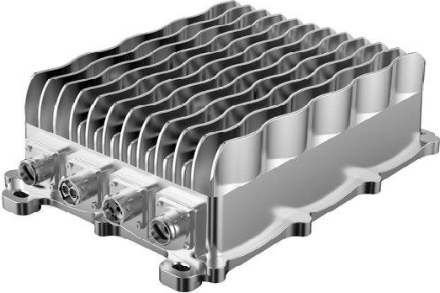

Nanocrystalline Soft Magnetic Materials (NSMM) Development Program
FeNb
Nano Ribbon
Magnetic Component
Power Component
Application
Core
CMC, HFT, PFC, CT, …
Inverters, power converters, power supply units, rectifiers,…
Ev’s, HVAC, smart meters, solar power gen, data centers…
CBMM supplies essential raw material (Fe-Nb) to global nanocrystalline ribbon producers ( 90+)
100% of Nanocrystalline Soft magnetic Materials available in the market today contains Nb .
Nano Magnetic Material Industry
Distributor
Power Convert
Manufacturers
Downstream
Ribbon
Core
Magnetic Component
Power Convert Designers
In a typical Nanocrystalline ribbons production, 5.6 % by weight of
Niobium is used . Along with other elements like Fe, Si, B and Cu
CBMM focus is disseminating its application in emerging markets

Slide 6

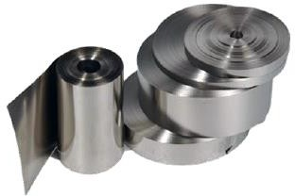
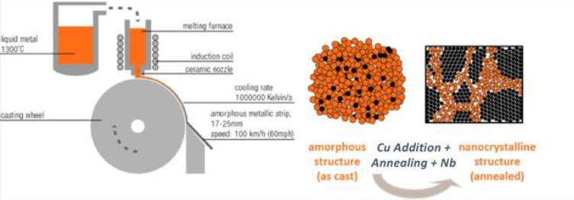
NANOCRYSTALLINE PRODUCTION PROCESS
Produced as thin ribbons
Production process
MELT SPINNING ANNEALING
Thickness of the sheet: 14-30μm
(↓ thickness - ↑ properties)
Ribbon width: usually 60-70mm
Firstly developed by Hitach in 1989 as FINEMET®
Standard chemical composition (small variations):
[(Fe)]_{83.4} [(Nb)]_{5.6} [(Cu)]_{1.3} [(Si)]_{7.7} [(B)]₂ – tradicional FINEMET®
chemical composition
Usually 5.5 to 6% of Nb in Chemical composition
Grains extremely small (~10nm) and uniform distribution
Source : VAC and Proterial

Slide 7

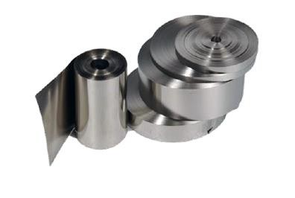

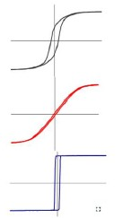
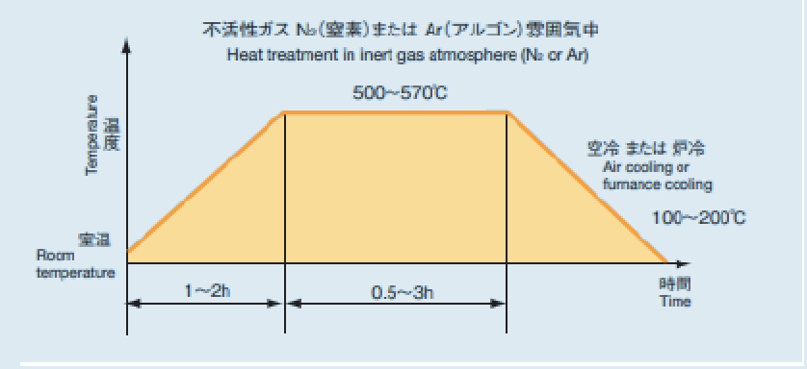

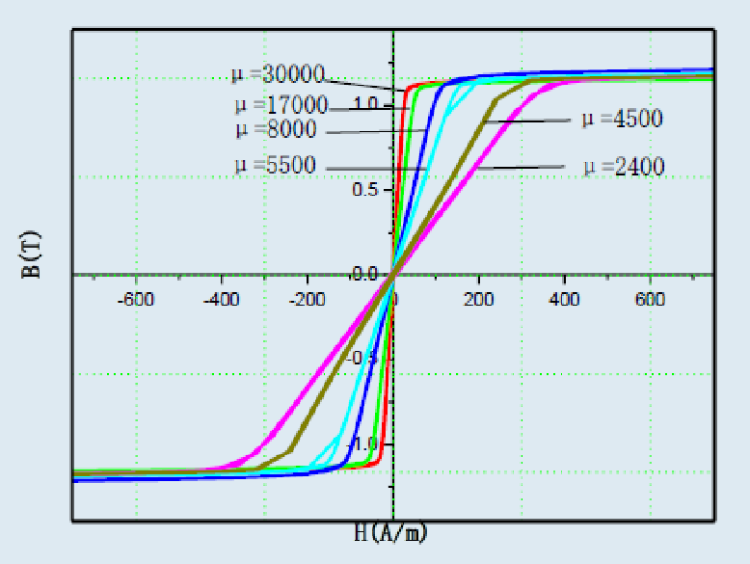
NANOCRYSTALLINE PROPERTIES
Ribbon thickness
Annealing treatment
Hysteresis curve
Permeability Frequency Saturation
14 - 18 μm
18 - 22 μm
22 - 26 μm
26 - 30 μm
> 30 μm
Ramp-up; Temperature; Soaking time;
Number of heating steps;
Applied magnetic field (longitudinal, transversal, none)
Source : VAC and Proterial

Slide 8

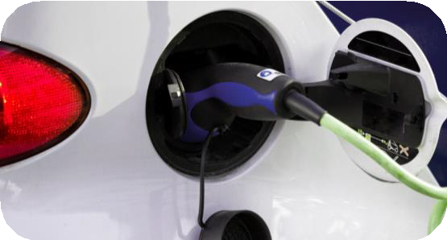


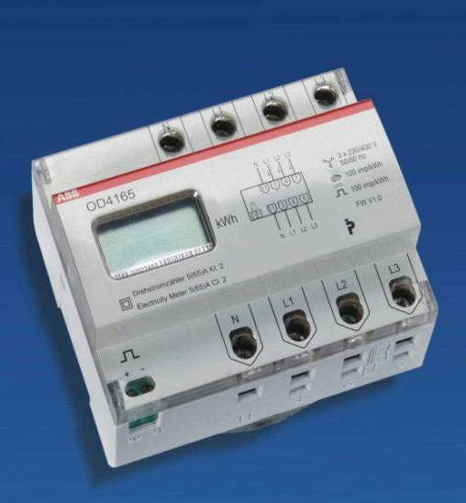


Nanocrystalline materials allow miniaturization while increasing performance of components
Major benefits of nanocrystalline materials
Systems
Smart meter
EV charging station
Onboard chargers and
Inverters for EV
Power converters
Data center - UPS
Electric motors
Solar PV Inverter
Components
CMC filters
EMI filters
DC filters
Current transformers
RCD Type A (6mA DC)
Dual active bridge transformers
PFC & DC Inductors
Motor stator…
Performance
Accuracy & Efficiency: 99%
Reduced core loss
Higher filter attenuation
Safety: fast
response time
Size reduction
Up to:
40% less copper windings
70% less weight
60% less volume
Properties shown in: Smart meters; EV charging IC-CPD; On board charger; Solar energy; Energy grid
Comparisons with standard materials: Ferrite; Permalloy; Amorphous; Sendust; MPP

Slide 9
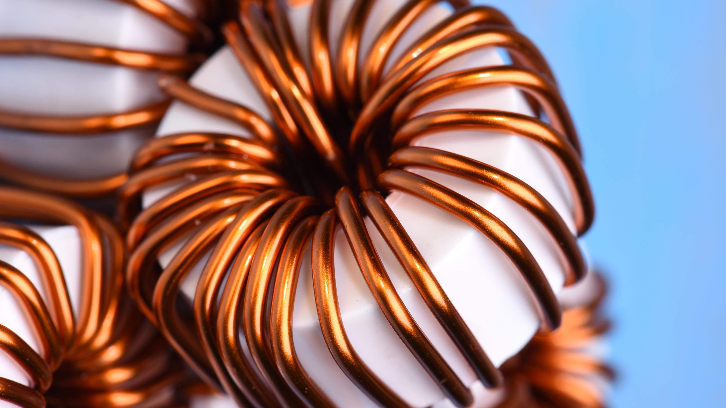
CMC and EMC for EV:
On-board & Off-board applications
Current Transformers for: Smart metering, Revenue metering, Data center BCM**, Industrial metering
Differential Current Sensor for EV charging stations: RCD Type A + 6 mA DC sensor
Medium frequency Transformer applications for high power electronics and solid-state transformers
DC-DC inductors and PFC inductors using Nanocrystalline powder cores and stress annealed cores
Wireless charging shields for mobiles
and EV charging
*NSMM=Nanocrystalline Soft Magnetic Materials
**BCM= Branch Circuit Monitoring
GROWING APPLICATION TRENDS FOR THE USE OF NSMM*

Slide 10
Low eddy current and fringing losses in windings
Very low core loss at higher frequencies (Transformers and Inductors)
MARKET NEEDS FOR POWER ELECTRONIC MAGNETIC COMPONENTS
Better thermal management (lower thermal resistance)
High power density
(lower weight and volume)
High permeability at wider frequencies (CMC and EMC filters)
Stable performance at wider temperatures
Different core shapes High voltage isolation Higher reliability

Slide 11
Shape limitations restrict NSMM to
There's a significant gap in information sharing between power electronic designers and NSMM producers
MAJOR CHALLENGES FOR APPLICATION OF NSMM* (MARKET FEEDBACK)
only toroidal and C/U core shapes
There is lack of commercially available NSMM with High frequency (>100KHz ) and High Bs(1.5T) for applications in transformer, inductors and motors
There's a lack of precise testing data and simulation models from suppliers, which is crucial for power electronic designers when selecting specific magnetic components
There's no dedicated digital hub for sharing information on global NSMM developments
*NSMM=Nanocrystalline Soft Magnetic Materials

Slide 12
Co-development between NSMM producers and power electronic companies is crucial
NSMM producers should aim to become comprehensive magnetic component solution providers, meeting market needs for complex power electronic topologies
Projects that support innovative manufacturing of new shapes need to be developed
Projects that support commercialization of high frequency and high Bs NSMM manufacturing
NSMM producers must provide users with precise test data and assist global power electronic simulation software by sharing appropriate simulation models
A digital hub should be created to facilitate the sharing of NSMM developments, involving all stakeholders in the NSMM field
*NSMM=Nanocrystalline Soft Magnetic Materials
CBMM PROSPECTIVE FOR OVERCOMING THE CHALLNGES

Slide 13
Investing in pilot studies/case studies with universities and industrial players to prove the benefits of using NSMM in emerging applications
High power density electric motors using NSMM* stator
NSMM testing and characterization Current transformers for energy metering
Magnetic components for EV charging
stations (Filters, RCD’s, Transformers , PFC)
High power density EV Onboard Chargers
Wireless Charging
CBMM DEVELOPMENT STRATEGY
FOR NSMM*
*NSMM=Nanocrystalline Soft Magnetic Materials

Slide 14

HOW A PARTNERSHIP WITH CBMM CAN BENEFIT PLAYERS ACROSS THE WHOLE VALUE CHAIN:
Magnetic Material Industry
EV
distributer
Power component manufacturers & assembler
Power converters
AC-DC, DC-AC and
DC-DC converters
Inverter
Booster converter
PFC system
Power Supply units
Data center
CBMM
Core producer & treatment
Magnetic component producer
CMC filter
HFT
PFC Inductor
Current transf.
Shielding
Ribbon
producer
HVAC
Solar
CBMM could offer:
Contact with all the top players of the supply chain involving
nanocrystalline solutions
Supply chain diversification and transparency
Bring in strategic partnerships with universities and companies for developing advanced magnetic solutions with nano
Contact with potential end-users of power electronics systems
Power component
developers & designers
Huawei • Siemens
ABB • Power Box
Hitachi • Recom
TDK • XP Power
Schneider • Kostal
Eaton • Others…
Others

Slide 15



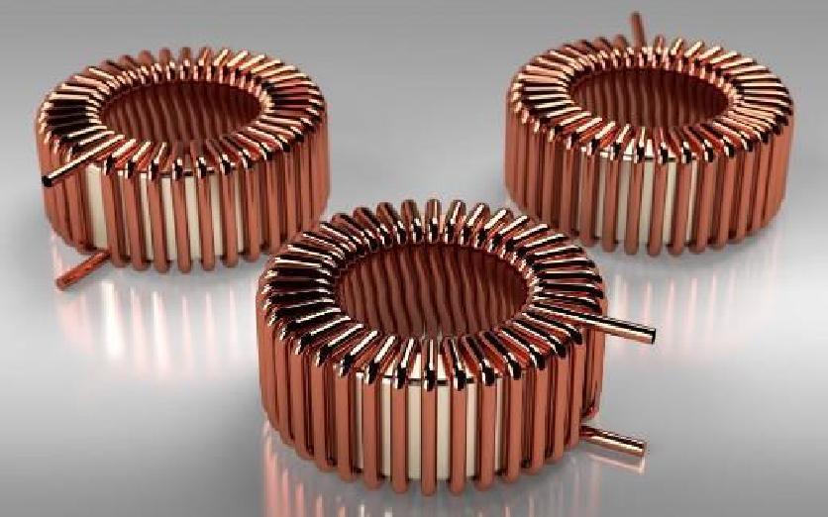
PARTNERSHIP WITH AMPED & PITTSBURGH UNIVERSITY
Standardized Testing of Materials and Electromagnetic Components
Benchmarking of Nanocrystalline Soft Magnetic Cores vs. Industry Standard
Three Applications:
High Frequency Transformer Harmonic Filter / Line Filter Current Transformer
Two Core Types:
Industry Standard Nanocrystalline

Slide 16
PARTNERSHIP WITH AMPED & PITTSBURGH UNIVERSITY
Core Testing Standards:
IEEE 393: 1991 IEEE Standard for
IEC 62044
Test Procedures of Magnetic Cores
IEC 62044-1:2000: Cores made of soft
magnetic materials – Measurement Methods Part 1
Generic specifications
Defines basic testing principles, selection of coils, magnetic conditioning (electrical / thermal)
Section 5 – Analytical terminology definition (core loss, apparent core loss, permeability, etc.)
Section 6 – Test procedures including two- winding method, bridge measurements, etc.
IEC 62044-2:2000: Cores made of soft magnetic
materials – Measurement Methods Part 2
Magnetic properties at low excitation levels
Includes terminology and parameters for test setups using impedance analyzer / LCR meter
IEC 62044-3:2000: Cores made of soft magnetic
materials – Measurement Methods Part 3
Magnetic properties at high excitation levels
Annex A and section 6: show the two-winding method, Annex B shows RMS method

Slide 17

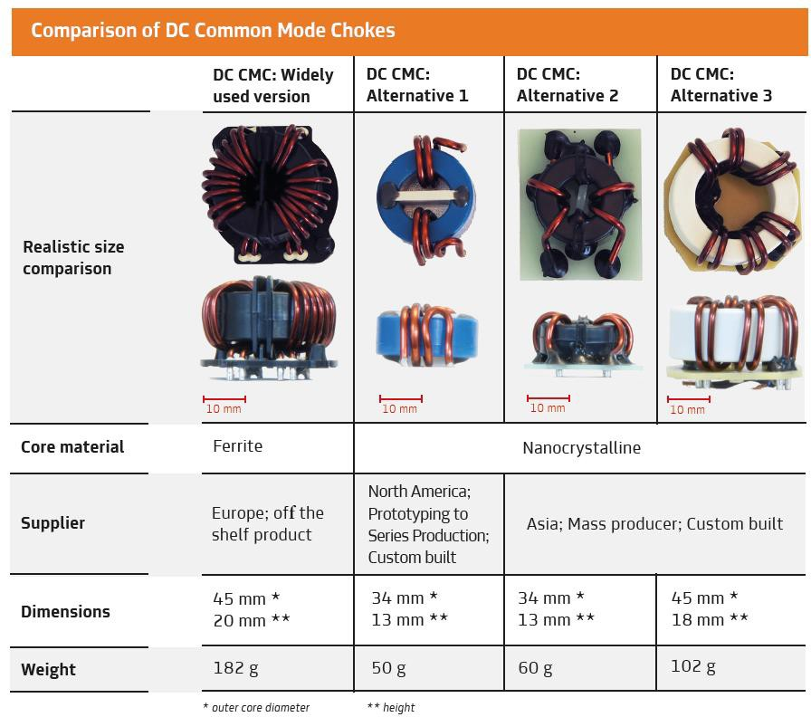

Comparison of DC Common Mode Chokes
DC CMC:
Windely used vesion
DC CMC:
Alternative 1
DC CMC:
Alternative 2
DC CMC:
Alternative 3
INNOLECTRIC CASE
With 1/3 of size and weight of a ferrite core, nano meets the efficiency and performance requirements for AC and DC Filters
Realistic size comartion
Advantages proved in showcase with Innolectric:
Up to 80%
Reduction in the cost with quotes for large quantities
Up to 60%
Reduction in the weight of the CMC
Core material
Ferrite
Nanocrystalline
North America, Prototyping to Series Production; Custom built
Up to 70% Reduction in the size of the core
Up to 25%
Improvement in the efficiency with reduced thermal losses
Supplier
Europe; off the shelf product
Asia; Mass producer; Custom built
Dimensions
45 mm *
20 mm **
34 mm *
13 mm **
34 mm *
13 mm **
45 mm *
18 mm **
Up to 20%
Improvement in the performance with higher attenuation
Weight
182 g
50 g
60 g
102 g
* outer core diameter
** height
Source: Innolectric paper, to be published in Q3/2023.

Slide 18
DC COMMON MODE FILTERS WITH NANOCRYSTALLINE WERE SHOWN TO BE 70 TO 80% CHEAPER THAN CURRENT SOLUTION WITH FERRITE
Economic analysis of DC common mode filters with ferrite (current solution) versus nanocrystalline (alternatives 2 and 3)
100%
90%
80%
70%
60%
50%
40%
30%
20%
10%
0%
Prices were quoted with leading Chinese component producer;
Main reasons for price reduction of the component using nanocrystalline:
Use of less magnetic material for the core (approximately 1/3 of the magnetic material is needed when using nanocrystalline, compared to ferrite)
Less copper windings
Current Solution
Alternative 2
Alternative 3

Slide 19

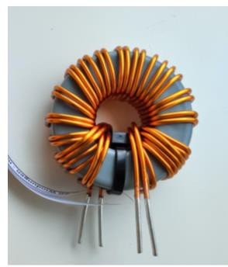
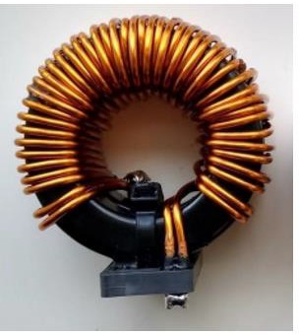
INNOLECTRIC CASE
Core material | PFGA- 20W1C | PFGC | Deviation*
manufacturer | Nanoamor | Ro-Lo | -
modell | N-D57H15U90 | CS572060 WEE 05880 | -
Inductance | 85 цH | 92 цH | -7.6%
Resonance frequency | 8 MHz | 7.3 MHz | +9.5%
Resistance | 0.04 ohm | 0.52 ohm | -92.3%
Parasitic capacitance | 4.66 pF | 5.17 pF | -9.8%
Core Saturation temp. @ op 1 (510V- 41A), (Power loss) | 175 °C. 126 W | 88 °C, 131.56 W | -14.7%
Core Saturation temp. @ op 2 (315V- 65A), (Power loss) | 68 °C, 90.46 W | 84 °C, 103.54 W | -19%
Winding diameter (WD)(mm) | 2x1.91 22,92 | 2 × 1.91 22,92 | 0%
Outer core diameter OD(mm) | 57.15 | 57.15 | 0%
Numbr of Turns | 20 | 23 | -13%
Consumed surface A=ODX(Height+2*WD)(mm²) | 870.96 | 1903.56 | -54.2%
Height(mm) | 15.24 | 2 × 13.97 | -45,4%
Volume(mm²) | 39093.74 | 110406.48 | -64,5%
Weight(g) | 219 (2.5g/1W) | 362 | -39,5%
EMI |  |  | -
Nanocrystalline powder cores outperformed Sendust cores for PFC Grid Filter in performance and efficiency
Advantages proved in showcase with Innolectric:
Up to 13%
Reduction in the number of copper turns
Up to 40%
Reduction in the weight of the PFC
Up to 65% Reduction in the size of the PFC
Up to 19%
Reduction in the operating
temperature
Up to 93% Reduction in the core resistance
Up to 10%
Reduction in the parasitic capacitance
PFGA -
Nanocrystalline cores
Source: Innolectric paper, to be published in Q3/2023.
PFGC -
Send Dust cores

Slide 20
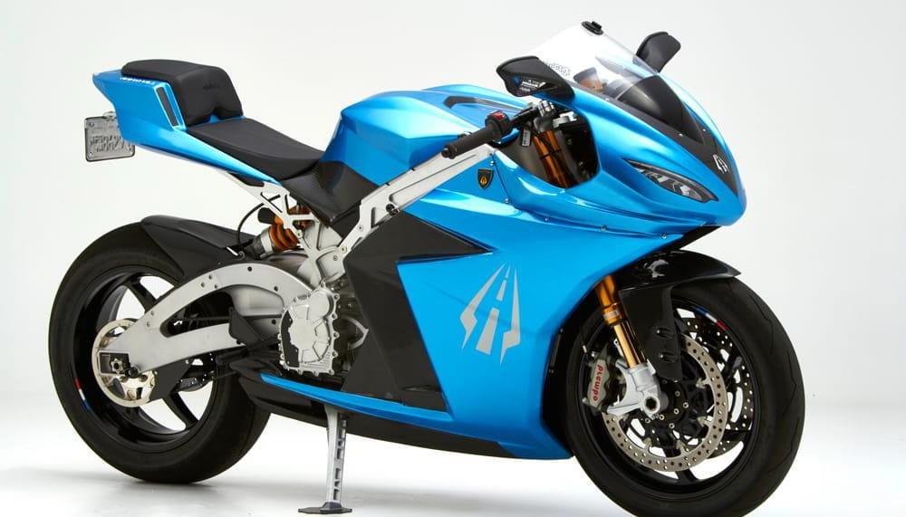
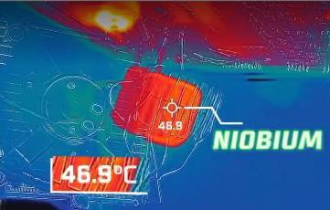

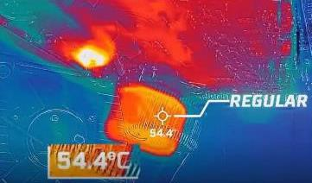
CBMM partnership with
Lightning Motorcycles(USA)
for Nanocrystalline powder cores pilot case study
Advantages proved in showcase with Lightning
Common Mode Choke
Miniaturization
40% less volume
Nano Powder
PFC Inductor
Motorcycle with Nanocrystalline magnetic components
Longer Lifetime Reduction of 7,5°C in the operating temperature
Sendust

Slide 21
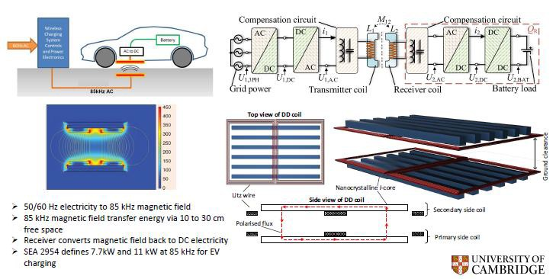
PARTNERSHIP WITH UNIVERSITY OF CAMBRIDGE: EV WIRELESS CHARGING (Prof Teng Long)
Basic concept of inductive power transfer (IPT)

Slide 22
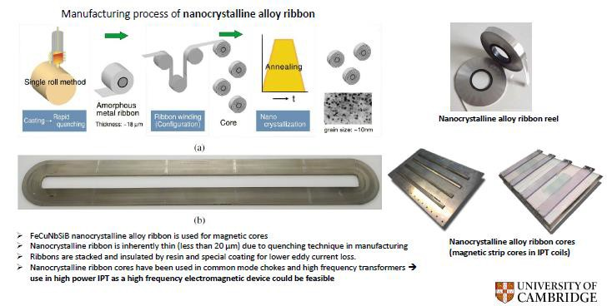
PARTNERSHIP WITH UNIVERSITY OF CAMBRIDGE: EV WIRELESS CHARGING (Prof Teng Long)
A novel magnetic core for wireless charging coils

Slide 23
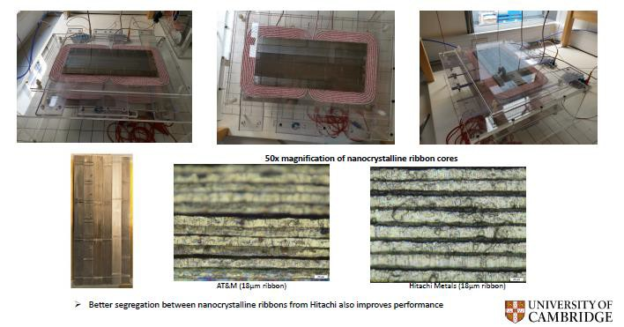
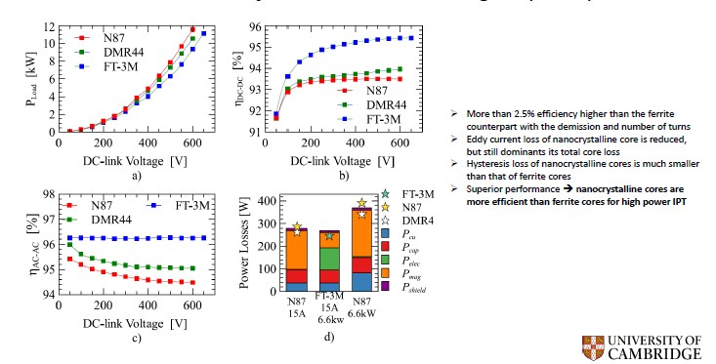
PARTNERSHIP WITH UNIVERSITY OF CAMBRIDGE: EV WIRELESS CHARGING (Prof Teng Long)
IPT Design 2 | Better nanocrystalline lamination
Performance of nanocrystalline core IPT Design 2 (11kW)

Slide 24
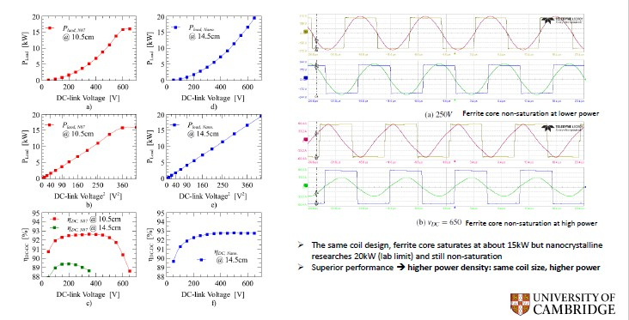
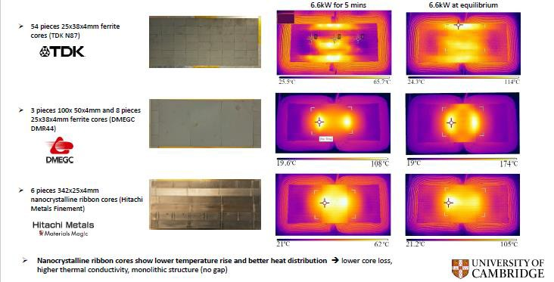
PARTNERSHIP WITH UNIVERSITY OF CAMBRIDGE: EV WIRELESS CHARGING (Prof Teng Long)
Higher power density (high saturation point)
Better thermal Performance

Slide 25
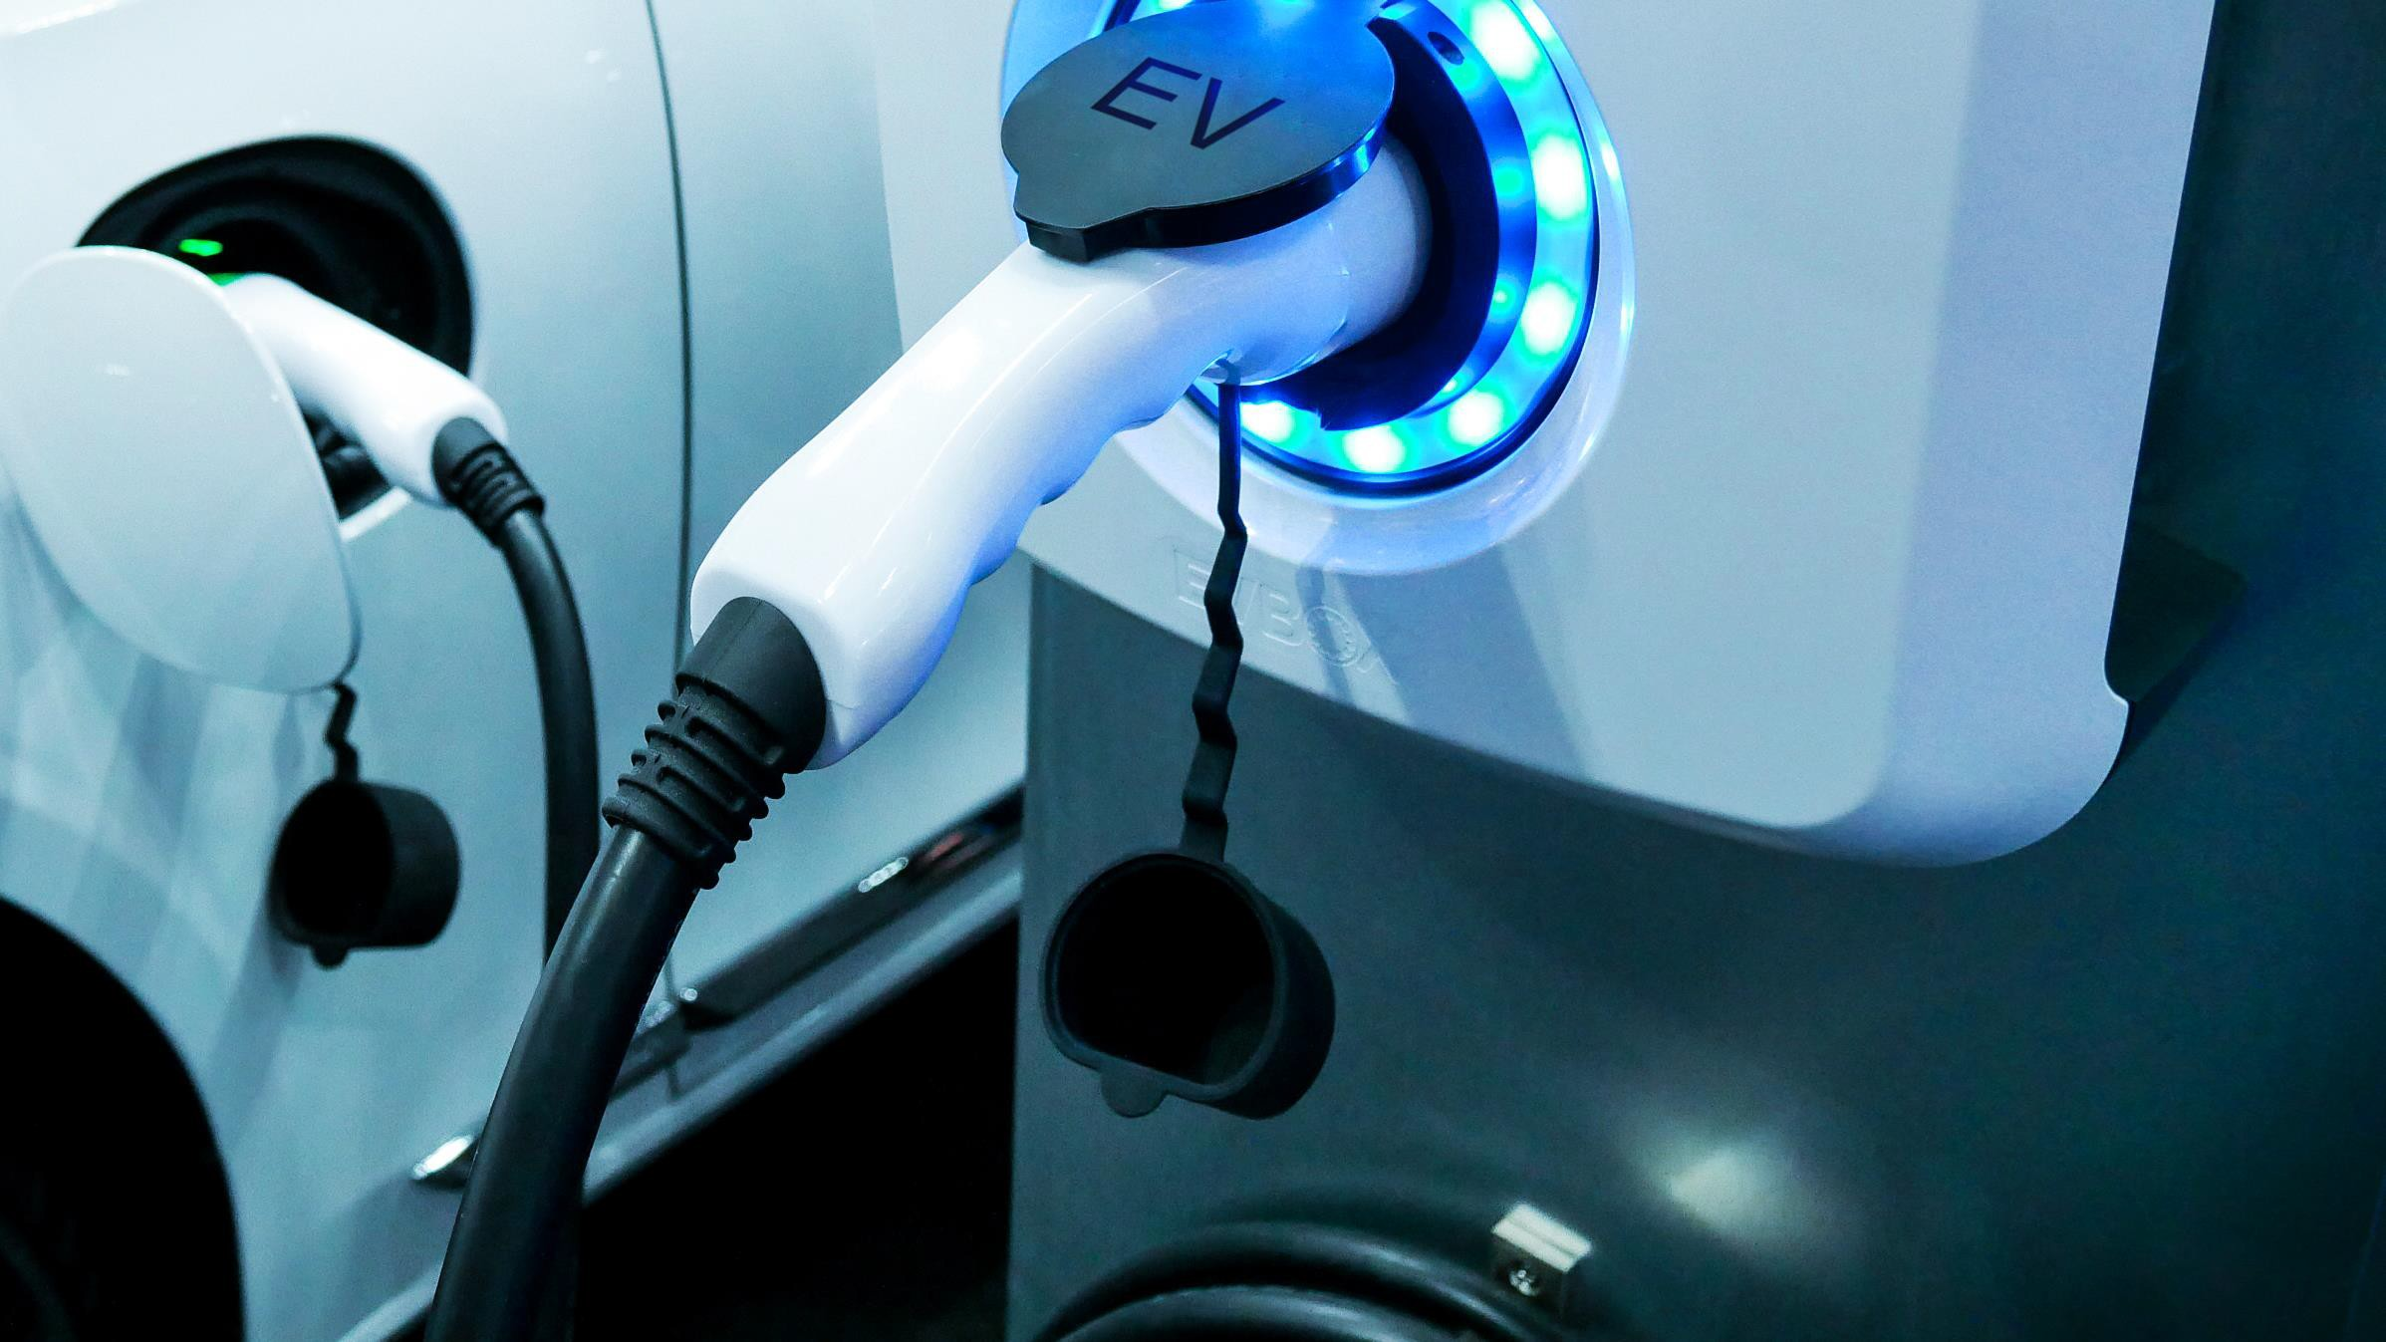
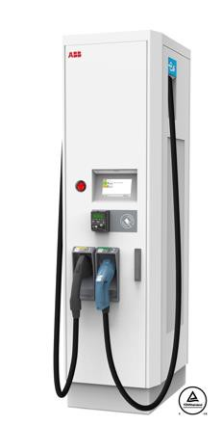
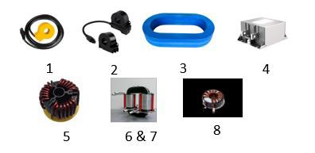

PARTNER T.B.D IN 2023
FAST CHARING EV CHARGING STATIONS
In the pipeline: EV DC Fast Charger with nano could be smaller, safer, more efficient and have reduced C footprint
Potential Use of Nano EV DC fast charger
Possible gains with Nano*
Performance
Accuracy 99%
Efficiency 99% Reduction in core loss
Higher filter attenuation at broad band frequencies Safety: fast response time
Size reduction
Up to:
40% less copper windings 70% less weight
60% less volume
ReducedC footprint
Dematerialization Up to 50% less
C footprint
Current transformers
Residual Current Detector
EMC Filters
EMI /EMC Filters
AC and DC Common mode choke
DAB Transformer (DC-DC)
Medium Frequency Transformer
PFC Inductors
Properties shown in following applications
Smart meters; EV charging IC-CPD; On board charger; Solar energy; Energy grid
Sources: VAC, Magnetec, KEMET, Schaffner, Innoelectric, Amogreentech
*Comparisons with standard materials: ferrite, permalloy, amorphous, sendust, MPP.

Slide 26
Investing in pilot studies/case studies with universities and industrial players to develop new materials and applications of NSMM:
NSMM based powder development using gas atomization process
High Bs (> 1.5T) NSMM ribbon development
NSMM thin ribbon development (<16 μm) for high frequency transformers and inductors
NSMM based high frequency motors for EV and industrial applications
CBMM FUTURE DEVELOPMENT STRATEGY
FOR NSMM*
*NSMM=Nanocrystalline Soft Magnetic Materials

Slide 27



Thank you!
LEARN MORE AT
www.niobium.tech

